Slide 1
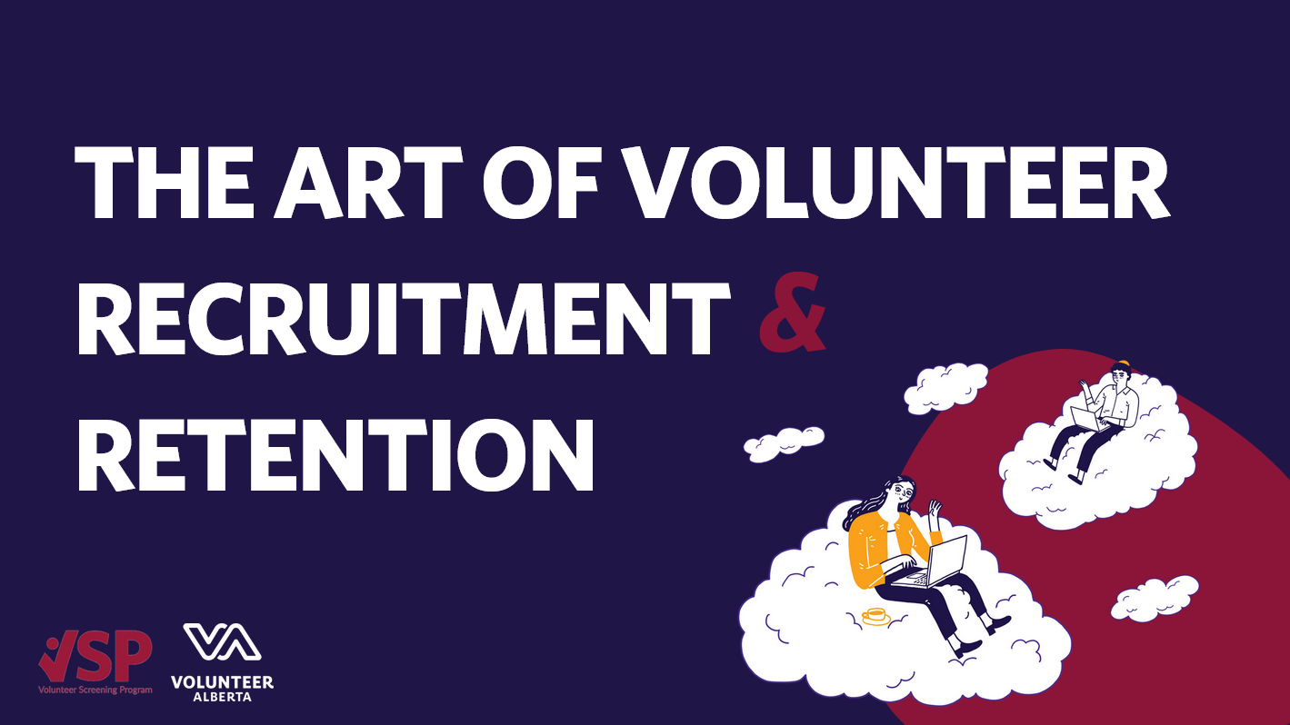
Notes:
My name is Erin Navarro. I am the Senior Coordinator, Learning & Resources at VA. I'm happy to have all of you join today. Welcome.

Slide 2
Notes:
Our main office is situated on Treaty 6 Territory, in an area that holds many Indigenous names but is referred to by the Nehiyaw people as amiskwaciwâskahikan (ᐊᒥᐢᑲᐧᒋᐋᐧᐢᑲᐦᐃᑲᐣ) and colonially as Edmonton. Our staff, board, and work extend into Treaty 4, 6, 7, 8 and 10 Territories, and we affirm the importance of honouring these historic agreements as well as all future treaties. The land we call Alberta is the ancestral territory and present-day home of many Indigenous peoples, including the Nehiyaw, Dene, Iyarhe Nakoda, Anishinaabe , Niitsitapi, Inuit, and Métis. We are grateful for their stewardship of this land, and as an act of reconciliation and good will, it is our intention to ensure that our organization, along with the entire social impact/non-profit/voluntary sector, can become good partners in supporting the land and communities.
As we talk about volunteerism and recruitment and retention, we can consider our connection and dependence on one another. None of us can accomplish impact in our community without each other. There is much we can learn from the indigenous people's of this land as we hope to support each other in our screening efforts. And I want to personally honour the land that I am on right now here in Mohkinstis in Treaty 7. You are welcome to join me in taking a breath in and out to acknowledge that land you are currently on.

Slide 6
HOW DO I GET MORE VOLUNTEERS?
And why is that the wrong question?
January 21, 2025
Scott Lundell
Edmonton Chamber of Voluntary Organizations
Capacity Building and Volunteerism

Slide 7
What are you asking them to do?
AGENDA
What are you waiting for?
What are the actual questions?
What are your barriers?
What’s your call to action?
Notes:
Today we'll take a bit of a step back when it comes to volunteer recruitment. It will be a bit oversimplified because of our time restrictions today. We're also going to talk about it in reverse order of the process because, actually, that's the way you should think about it.
We'll talk about what you're offering. You're never just looking for warm bodies. What is the job or task and how does it align to your organization, cause, and more importantly, the people you serve?
We'll talk about gaps in your recruitment process. Not in terms of what you're missing. But in the moments of silence your new people are experiencing.
We'll talk about the barriers you've got in your recruitment process. Some things are necessary, but is it all necessary?
We'll talk about how you stand out with your messaging. How do you make your call to action compelling?

Slide 8
WHAT ARE YOU ASKING THEM TO DO?
PROVIDING JUST WORK
Make sure it aligns
Be clear about expectations
Be clear about the commitment
Make it compelling
Demonstrate how it creates impact
Be flexible
Notes:
Make sure it aligns with your Vision/Mission/Values. Make sure it aligns with strategic plans and other goals and objectives.
Be clear about expectations. And not just for the potential volunteer. Make sure your team is also clear on the role. Have a job description and make sure it has a brief summary.
Don't undersell them. A board member doesn't just attend a 2 hour meeting every month. Lifting heavy boxes needs to be explicit. The ability to do math
Make sure the work will be compelling. Don't fill the position with menial tasks. And if you do, make sure you ask someone who wants to do menial tasks.
Demonstrate how the work has impact in the community. The work isn't really about your organization. Ultimately, it's about who you serve.
Be as flexible as you can. Think about travel time, child care, breaks, remote work, and anything else that reduces barriers to involvement.

Slide 9
WHAT ARE YOU WAITING FOR?
TIME IS YOUR ENEMY
Go through your process
Flag down time
Fill the time gaps
Notes:
Take the time to go through your own screening and onboarding process. Start from the moment someone engages with your organization whether that's your website, an email, a social media inquiry, or a phone call.
Identify the down time. Where are there lags in communication? Do they have to get a police record check and wait for that? Do they have to wait for you to check references?
Find things to engage them with. Educate them about the cause. The day after you interview them? Send them a YouTube video. Day 3? Send them your annual report. Day 7? Reach out with a status update. Start building the relationship now.

Slide 10
WHAT ARE YOUR BARRIERS?
INTENTIONAL RISK MANAGEMENT
First impressions
Eliminate unnecessary steps
Reduce paperwork
Make it as seamless as possible
Notes:
What's the first thing people see when they engage with you?
Is something redundant? Are you doing screening overkill? Do you actually need that police record check? Do a full-on risk assessment if you need to. And if you need to take these steps, make sure your candidate understands why they're doing it. There's nothing more frustrating than filling out a form or answering a question if you don't understand the context.
Reduce the amount of administrative paperwork. Make it mobile if you can. Only make them fill out what's necessary.
Make it happen all at once if you can. Rip the bandaid.

Slide 11
WHAT’S YOUR CALL TO ACTION?
STRATEGIC MESSAGES
Volunteers Needed
Desperation reeks of desperation
Generic messages don’t work
Understand your ideal audience
Tailor your messaging
Strategic placement
Volunteers Desperately needed!
Make a difference today
Join Our Team
Notes:
Your need for volunteers isn't a reason for me to do anything about it. Why should I reach out? What's going to compel me? "Volunteers Needed" or "Volunteers Wanted" isn't a call to action. "Join our Team" or "Become a volunteer" are just as bad.
Even worse, "Volunteers Desperately Needed" is a terrible message to send. When you sound desperate, you sound unsustainable, disorganized, or chaotic. And as your desperation grows, your standards decrease as to who you'll accept.
Terms like "Make a difference" or things like stock photography water down your messaging. Being milquetoast doesn't work.
Know your ideal person. What skills do they possess? What characteristics do they have? While it's important to understand your needs, you also need to think about who your ideal candidate is. Once you know, talk to them in your marketing materials.
And then put those messages where they'll read them.

Slide 12
WHAT ARE YOU ASKING THEM TO DO?
WHAT ARE YOU
WAITING FOR?
PROVIDE JUST WORK
TIME IS YOUR ENEMY
WHAT ARE YOUR BARRIERS?
WHAT’S YOUR CALL TO ACTION?
INTENTIONAL RISK MANAGEMENT
STRATEGIC MESSAGES

Slide 13
QUESTIONS

